Slide 1
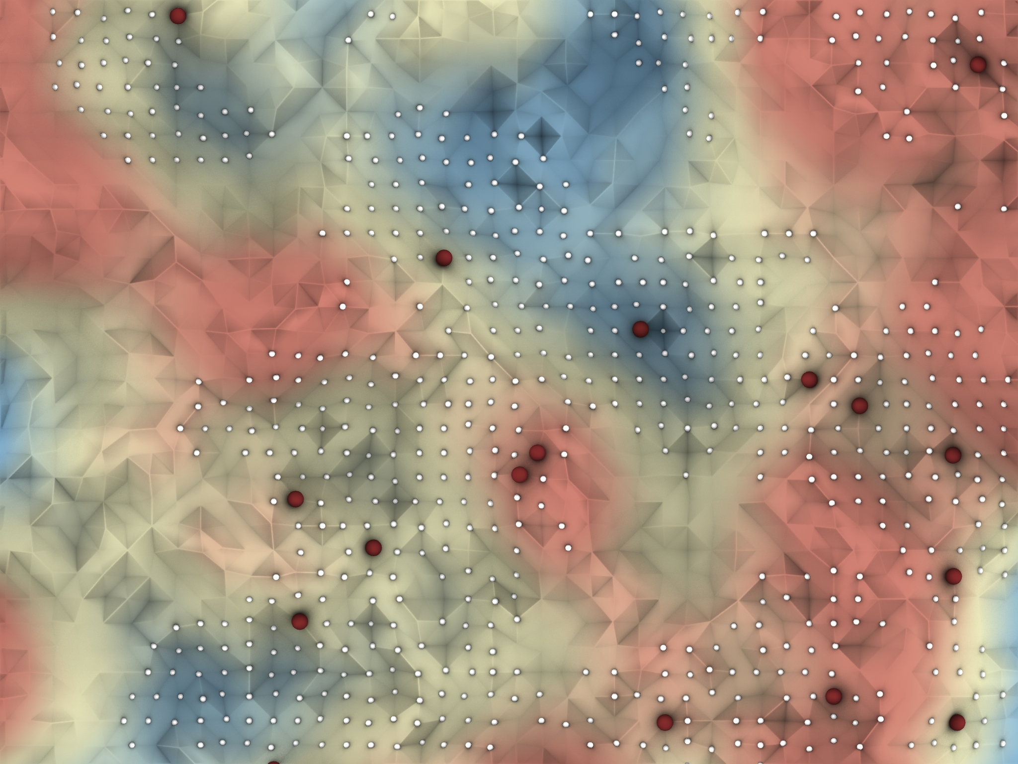
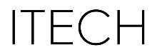
EARTH DIGGERS
Alan Eskildsen
Mengxi He
Philipp Kragl

Slide 2
PROPOSAL
Site preparation and earth relocation is proposed as a viable application for autonomous robotics, given its relative simplicity in relation to other types of construction tasks.
We envision a system that works with environmental perception, which is key for a safe deployment of autonomous robotics.
This has a fundament in the availability of state-of-art sensors in the industry, which offer the possibility of perceiving 360 degree views (eg. camera, RADAR & LiDar), as well as object detector algorithms such as Voxel Net (Apple Inc.) for processing clouds of points with lower computational cost.
Source: https://towardsdatascience.com/lidar-point-cloud-based-3d-object-detection-implementation-with-colab-part-1-of-2-e3999ea8fdd4

Slide 3
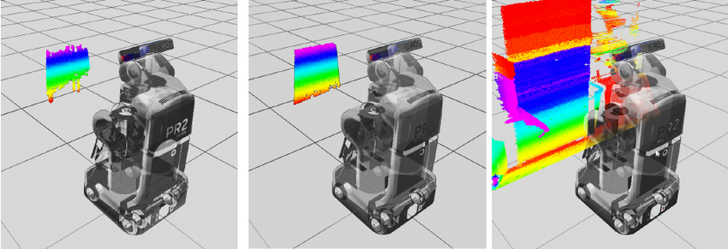
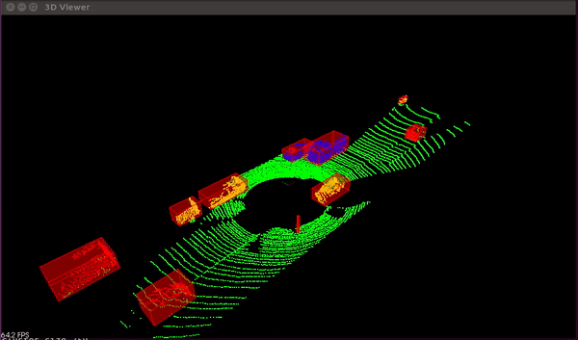
Robot perceiving 3d-point cloud [2]
KITTI point cloud viewer [1]
Source: LiDAR point-cloud based 3D object detection implementation with colab {Part-1 of 2}, https://towardsdatascience.com/lidar-point-cloud-based-3d-object-detection-implementation-with-colab-part-1-of-2-e3999ea8fdd4
Source:, Charlie Rides the Elevator-Integrating Vision, Navigation and Manipulation Towards Multi-Floor Robot Locomotion https://www.researchgate.net/figure/Visualization-of-the-robot-perceiving-3-D-point-clouds-through-various-sensors-Note-that_fig4_260730457
Notes:
We envision a system that works with environmental perception, which is key for a safe deployment of autonomous robotics.
This has a fundament in the availability in the industry of state-of-art sensors, which offer the possibility of perceiving 360 degree views (eg. camera, RADAR & LiDar), as well as object detector algorithms such as Voxel Net (Apple Inc.) for processing clouds of points with lower computational cost.

Slide 4
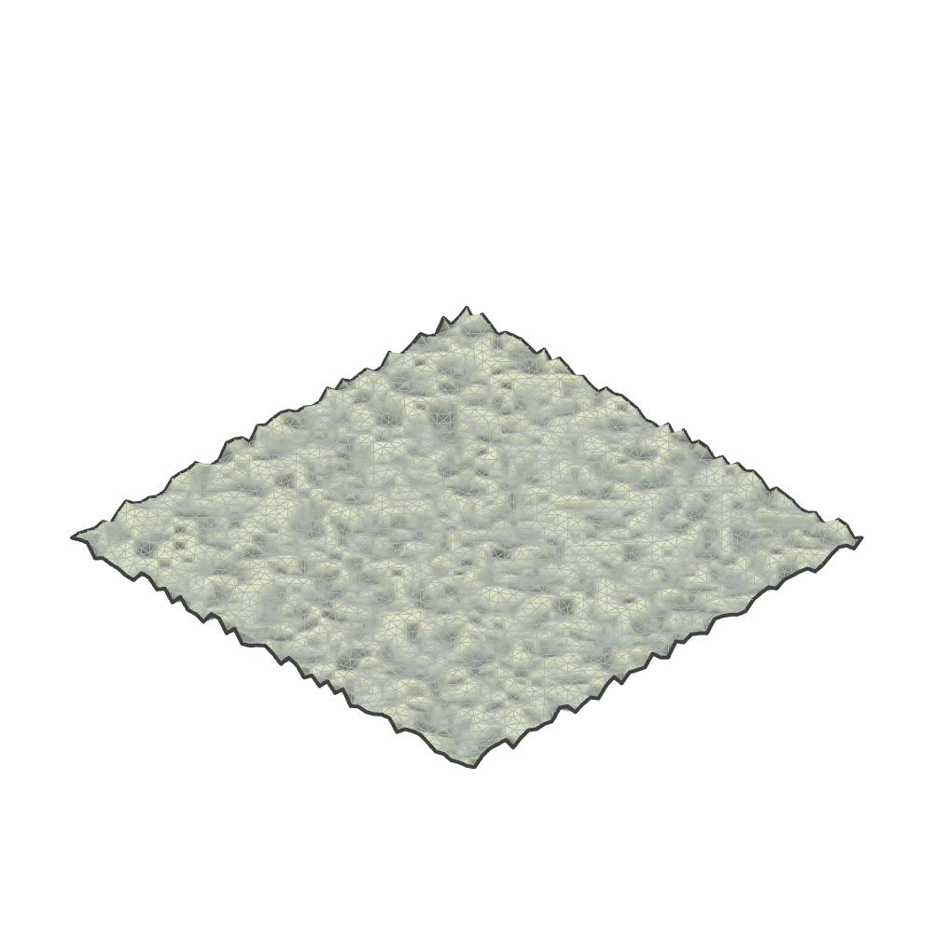
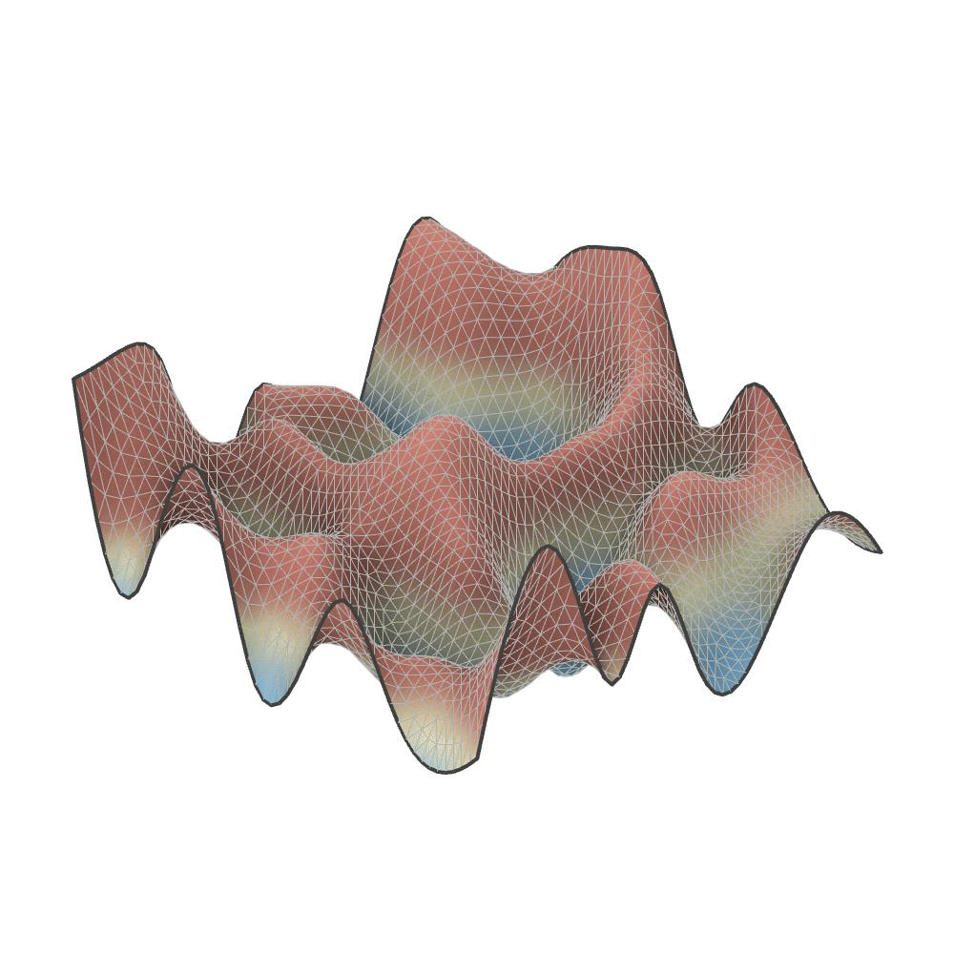
Mesh Environment
Random Topography Generator
Random Texture Generator
Notes:
Mengxi
The environment for our agent system is a mesh environment. In upstream modelling, we made a terrain generator that can generate a triangular mesh that simulates a rough terrain which contains Vallies and Peaks.

Slide 5
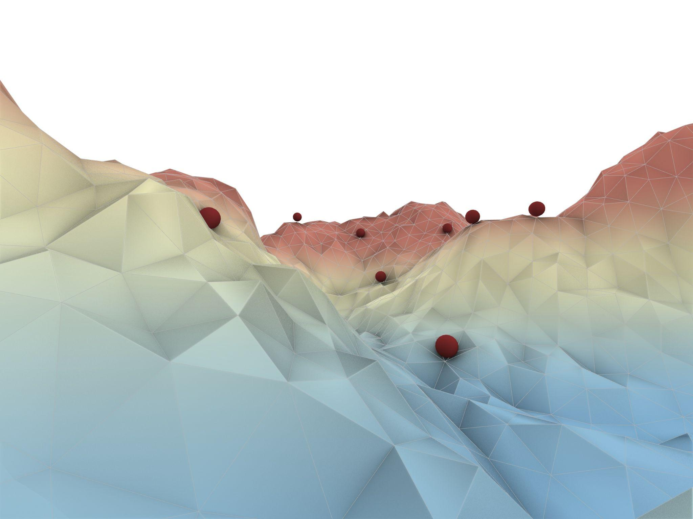
Robot Agents : Boid Agent System
Notes:
Mengxi For the Agent System. We have dynamic robot agents as boids. And a boid agent system

Slide 6
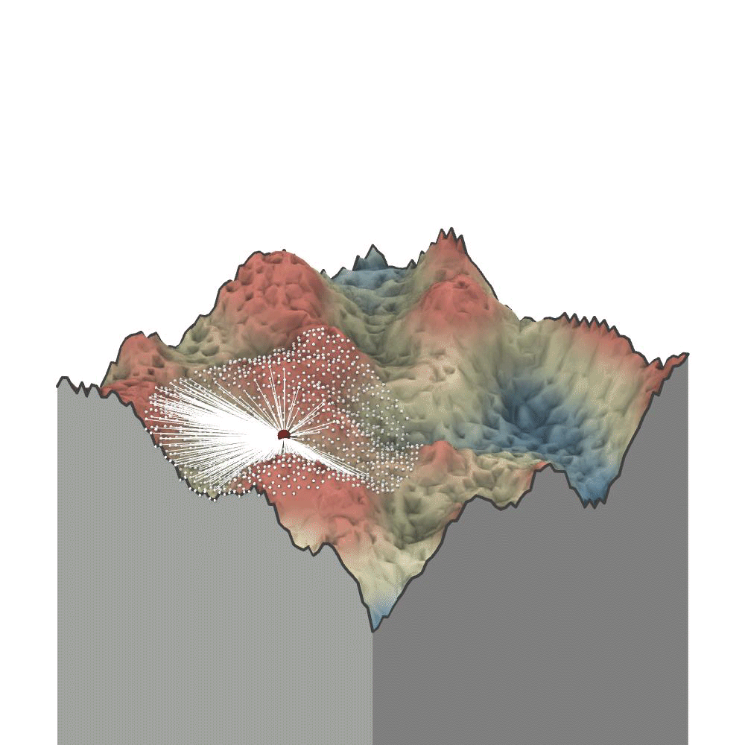
Digger Behaviour : Vision
Notes:
The first part of our custom Digger Behaviour is the vision
With its overarching logic being the detection of mesh vertices that are directly visible in a specific distance range from the agent at every iteration.
This sequence is used to ensure the robot is only taking decisions according to its own interpretation of the surrounding environment

Slide 7
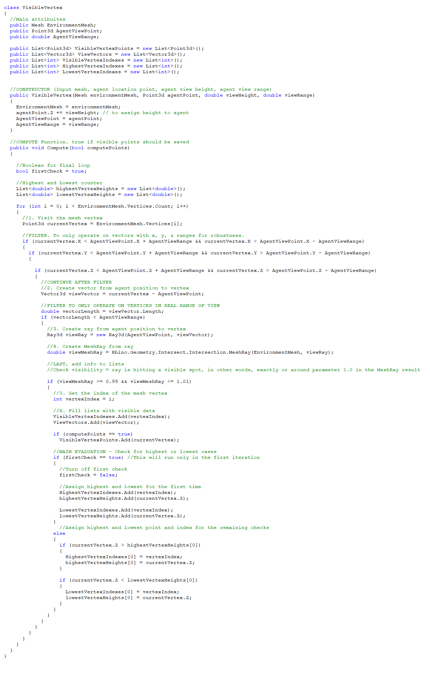
Digger Behaviour : Vision Class
1. Filter for robustness only points in range XYZ
2. Second Filter for points in range
3. Calculate Mesh-Ray intersection from agent to mesh
4. Select mesh rays with intersection at Parameter 1 to corroborate it is in line of sight
Notes:
Given that this can rapidly turn into a computationally heavy process Various filters were put in place sequentially.
The first one to ensure only certain vertices are processed according to their x y and z distance from the agent, and the second according to their euclidean distance from the agent.
The Intersection.MeshRay command shown in step 3 calculates the intersection with the mesh in the direction of the vertices, which later lets us corroborate if such vertex is in line of sight

Slide 8
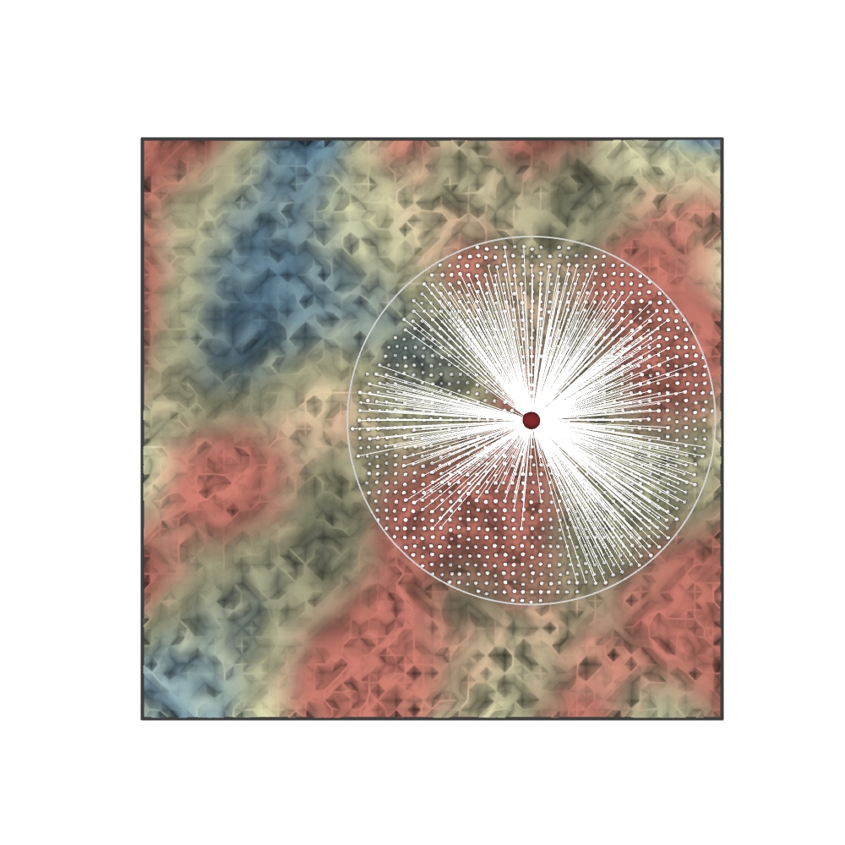
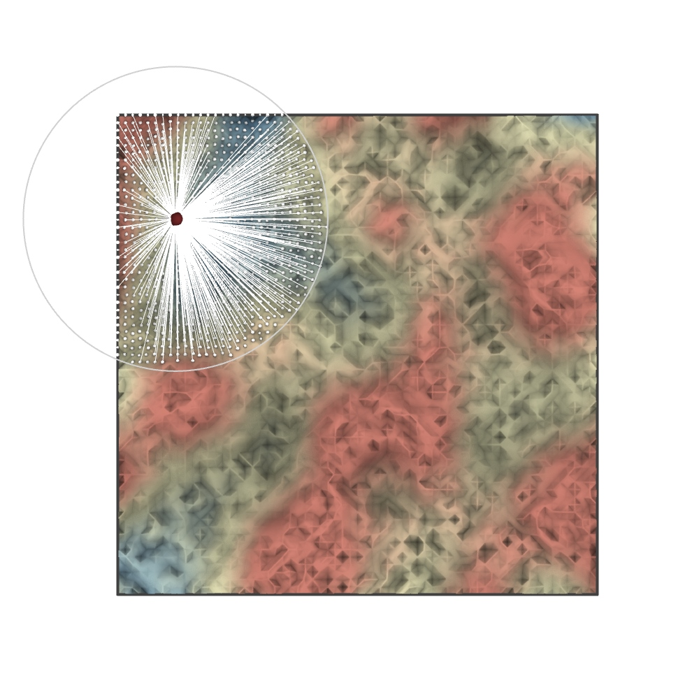
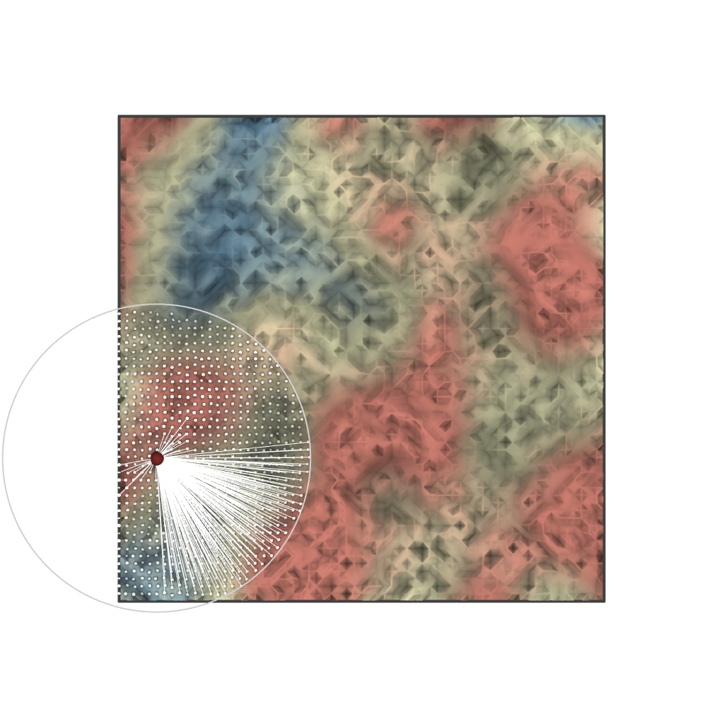
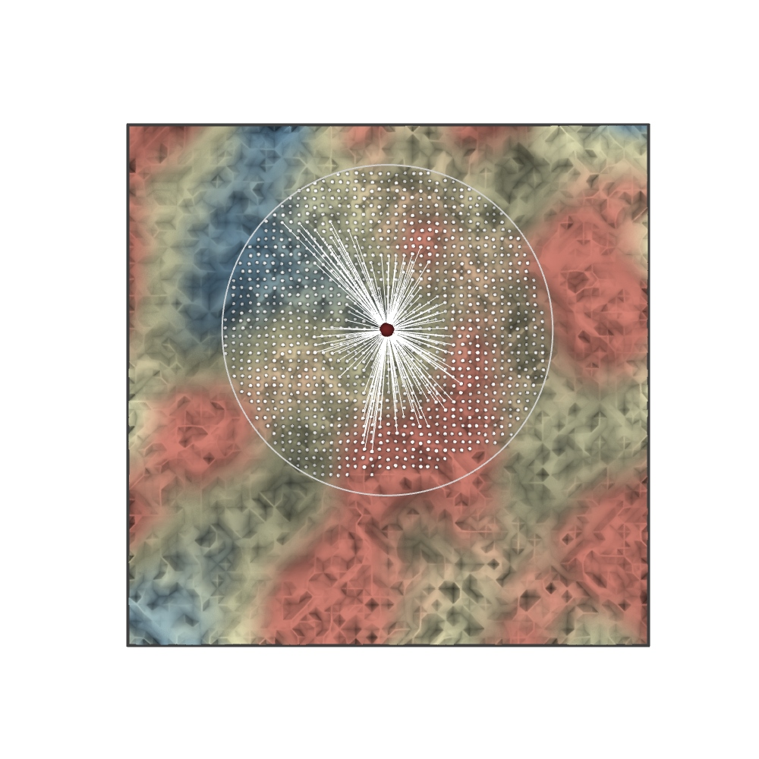
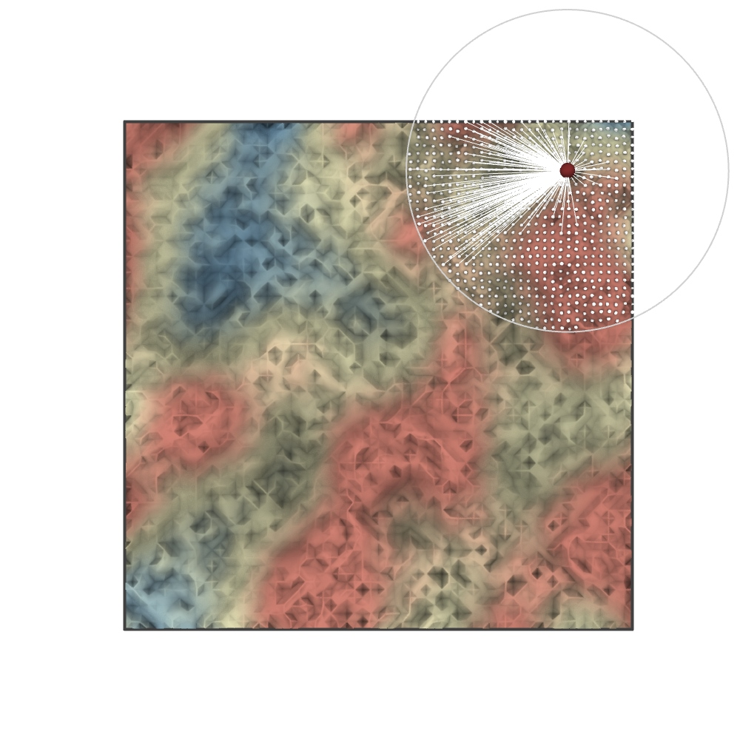
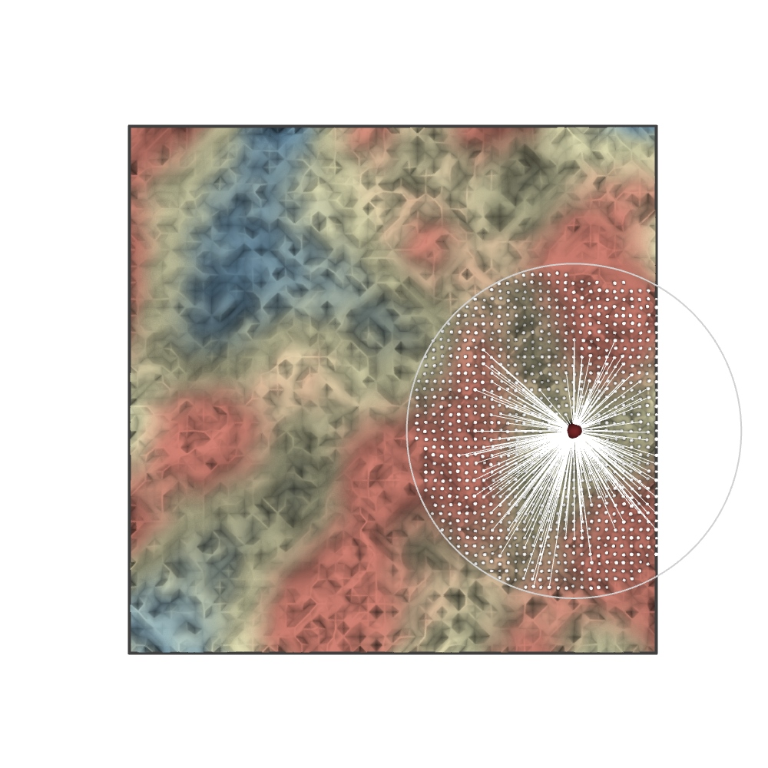
In range - 991
Visible - 379
Ratio - 0.38
In range - 850
Visible - 526
Ratio - 0.62
In range - 985
Visible - 276
Ratio - 0.28
In range - 1208
Visible - 208
Ratio - 0.17
In range - 681
Visible - 209
Ratio - 0.30
In range - 1005
Visible - 302
Ratio - 0.30
Notes:
ALAN
Here is a comparison on a mesh between vertices in range of the agent and the directly visible ones.
In this specific case the ratio between vertices in range and those that are actually visible varies from 17% up to 62%, depending on the agent position in the environment.

Slide 9
Digger Behaviour : Vision Class
5. From visible points select highest and lowest for behaviours
Notes:
ALAN
The last part of the vision class is the assignment of highest and lowest visible points which are crucial for the
Now Mengxi will explain the logic behind the remaining behaviours and the state machine

Slide 10
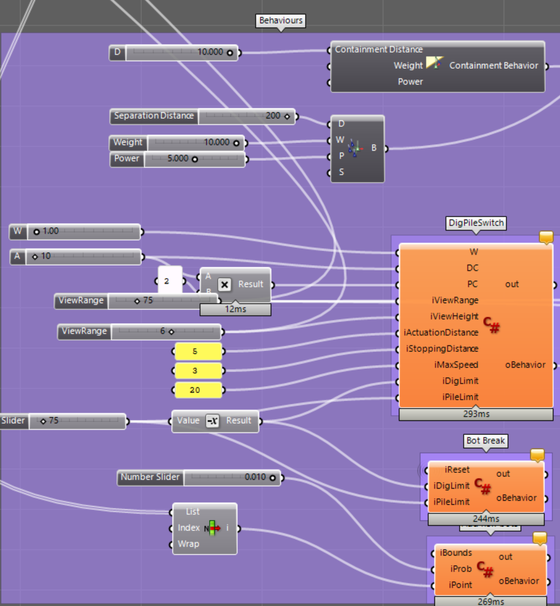
Digger Behaviour : Overview
Notes:
So here is a overview for our behaviors, we have the standard containment and separation behavior, for custom behaviors, we have the dig and pile switch, bot break and add new agent behaviour, and i will explain them more in detial

Slide 11
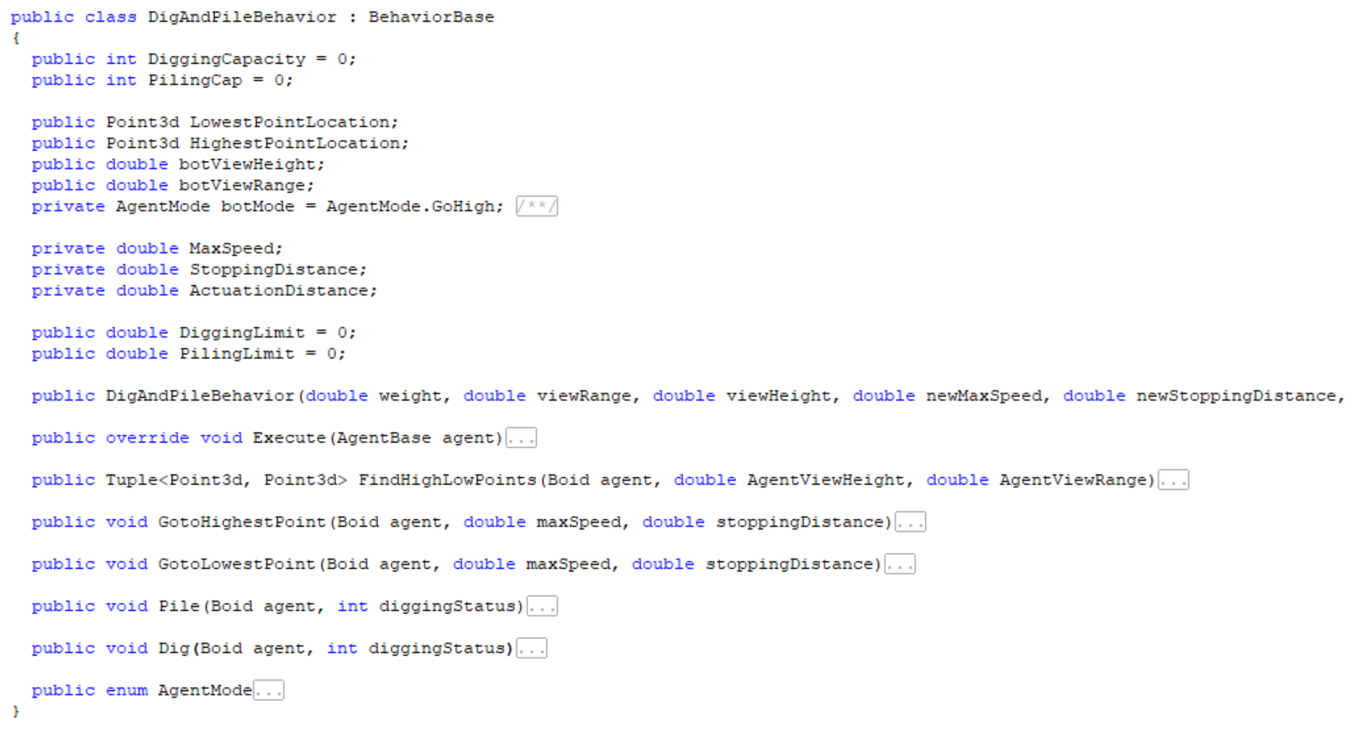
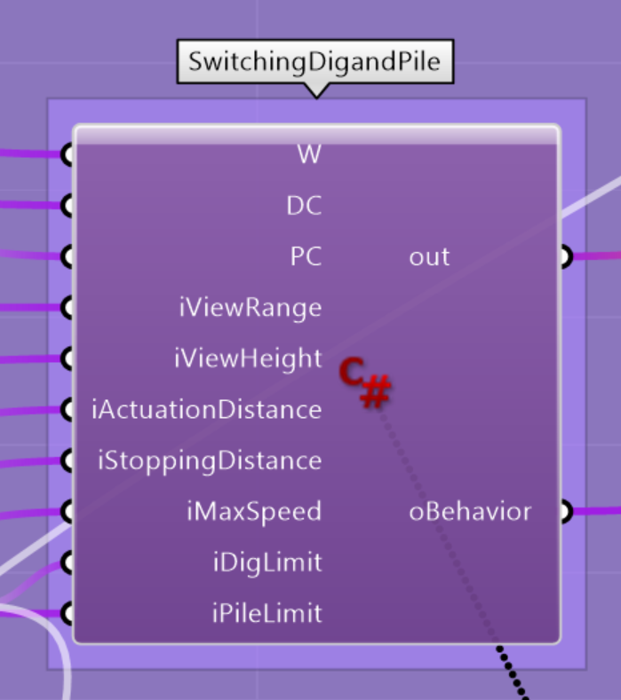
Digger Behaviour : Dig and Pile Switch
Functions:
FindHighLowPoints
GotoHighestPoint
GotoLowestPoint
Pile
Dig
AgentMode
Notes:
Mengxi The most important behavior for the agent is the Swithcingdigandpile behabior. This behavior allows the agent to find the highest and lowest point, and switch between different acts. In this behavior class, there are 5 functions: FindHighLowPoints, Goto HighestPoint, GotoLowest point, Pile and dig. Since we want the robot to know how much load it is taking, and able to pause their current act while starting another task. We are keeping track of the Digging load status. Once the digging cap is reached. The agent switch its behavior to Pilling, once the diggingstatus reaches the pilling cap. The digging status is set to zero in order to switch to digging again.

Slide 12
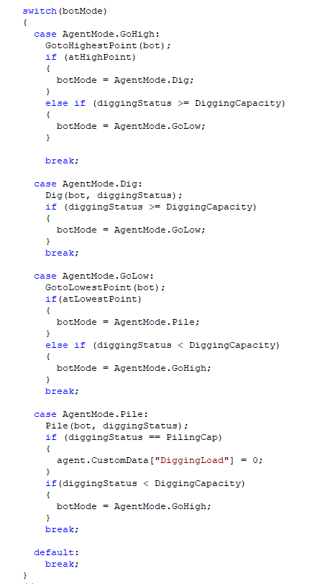
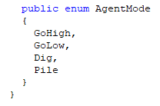
State Machine
Stay in state GoHigh until conditions are met
4 states
Stay in state Dig until…
Stay in state GoLow until…
Initialization
Stay in state Pile until…
Notes:
Mengxi A State machine structure is implemented into the execution function to help us switching the different states. In total, the robots posses 4 different states in this behavior. GoHigh, GoLow, Dig and Pile. The robot is initialized with the state: goHigh. Then the switch is implemented in the execution for the switching of different states.

Slide 13
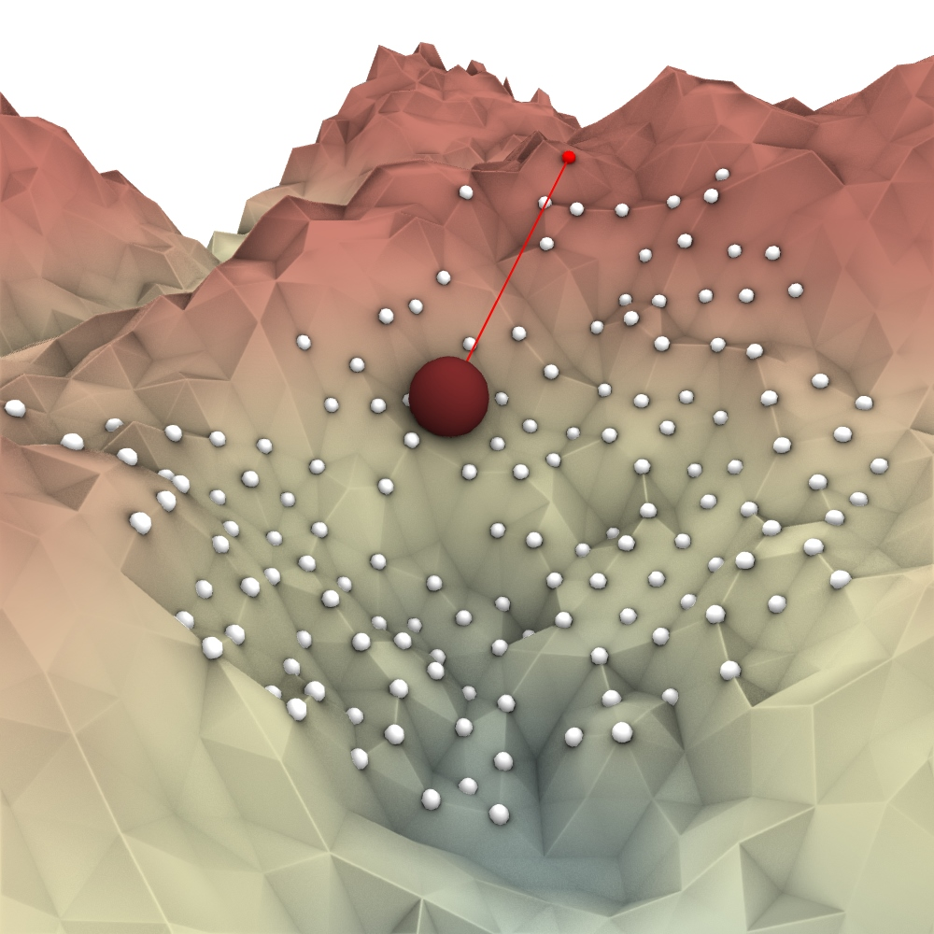

Digger Behaviour : GoUp or GoDown
Notes:
Menxi Here we are showing the Goup and goDown states visually. Derived from the vision of the agents. The agents will know where is the highest and lowest point within their vision zone and able to go up and down towards them.

Slide 14
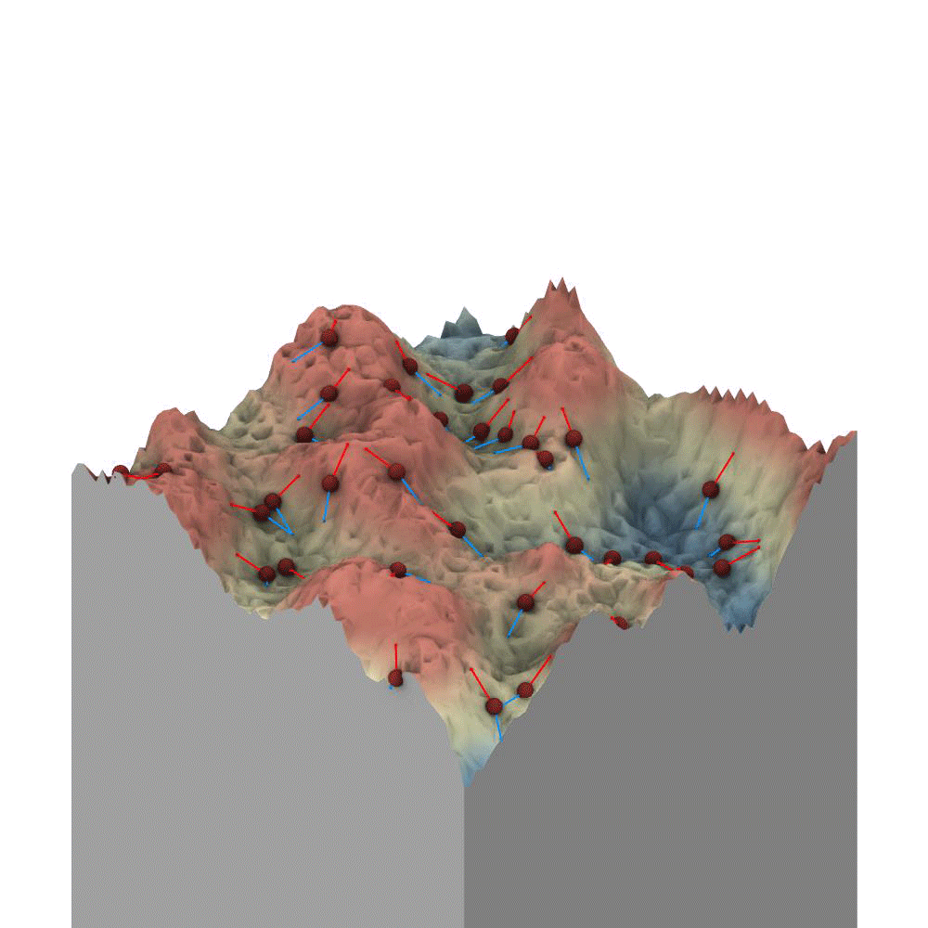
Digger Behaviour : GoUp or GoDown
Notes:
Mengxi Here is a animation showing them going up and down according to what they can see and their assigned behavior.

Slide 15
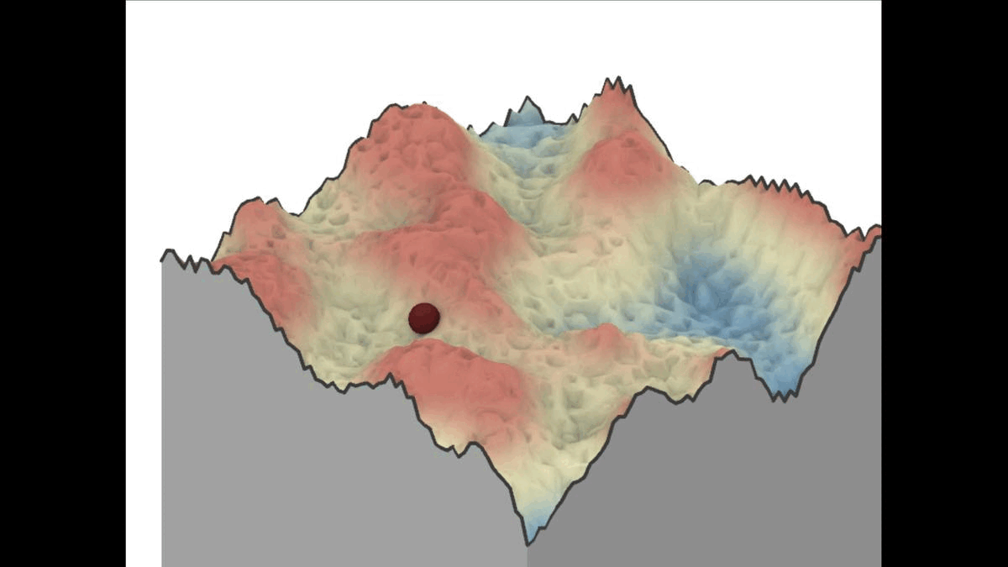

Digger Behaviour : Piling & Digging
Notes:
Mengxi These are the Pilling and Digging behaviors individually acting.

Slide 16
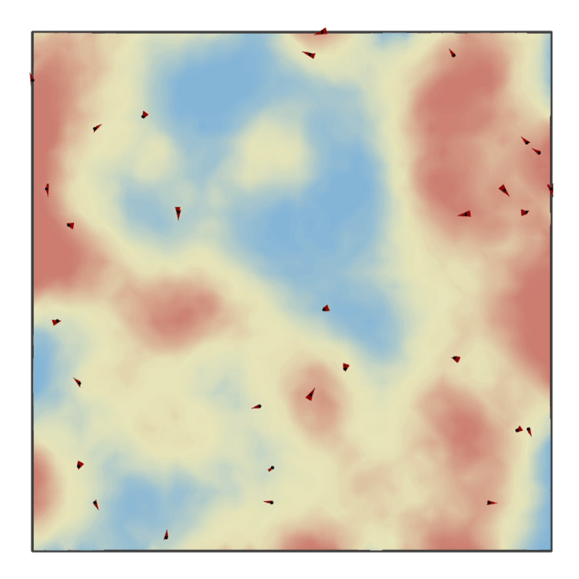
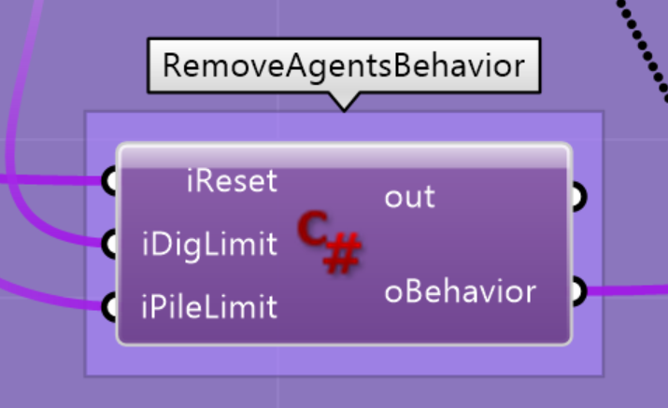
Digger Behaviour : Bot Break
Bot break if:
Bot Velocity == 0;
Bot.Position.Z == iDigLimit;
Bot.Position.Z == iPileLimit;
Notes:
Mengxi Through our simulations, we found out that the agents sometimes get stuck in an area due to they are too high or too low that they are not able to see other parts anymore. there fore we implemented another behavior bot break, the bot will break if the velocity is 0 or too close to the digging limits.

Slide 17
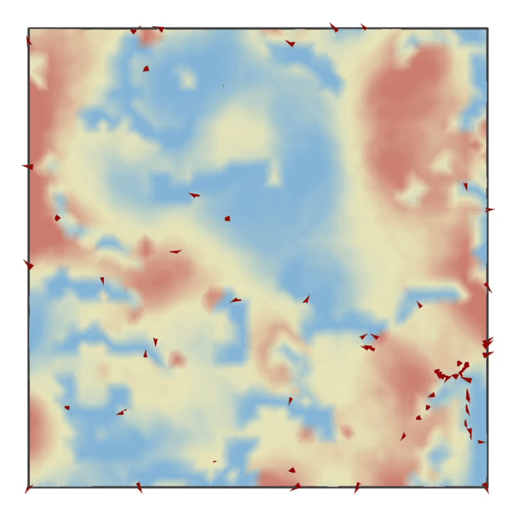
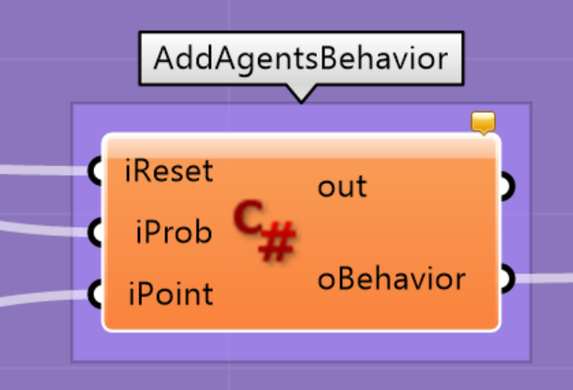
Digger Behaviour : Generate New Bot
When Number of Bots < minBot number
Generate Bot at Location iPoint
With iProbability
Notes:
Mengxi Logically, there is also the generate new bot behavior. New bot will be generated when the total amount of bots is too low.

Slide 18
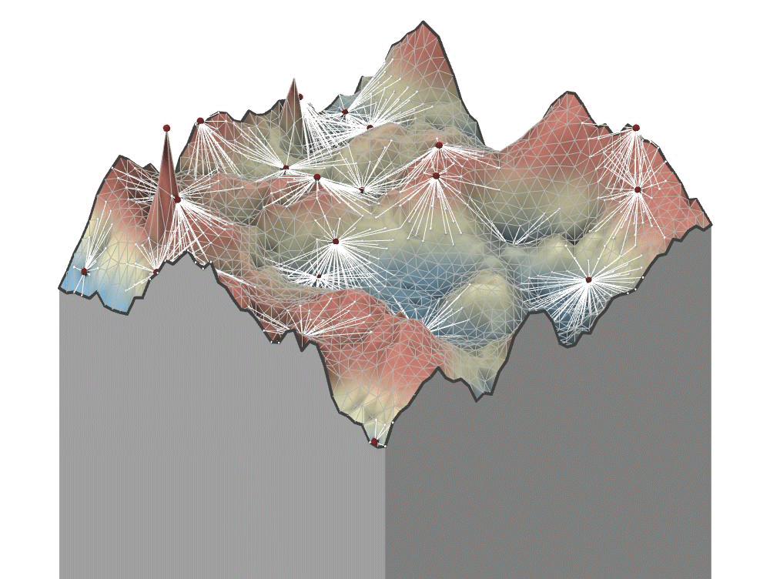
Combined Behavior

Slide 19
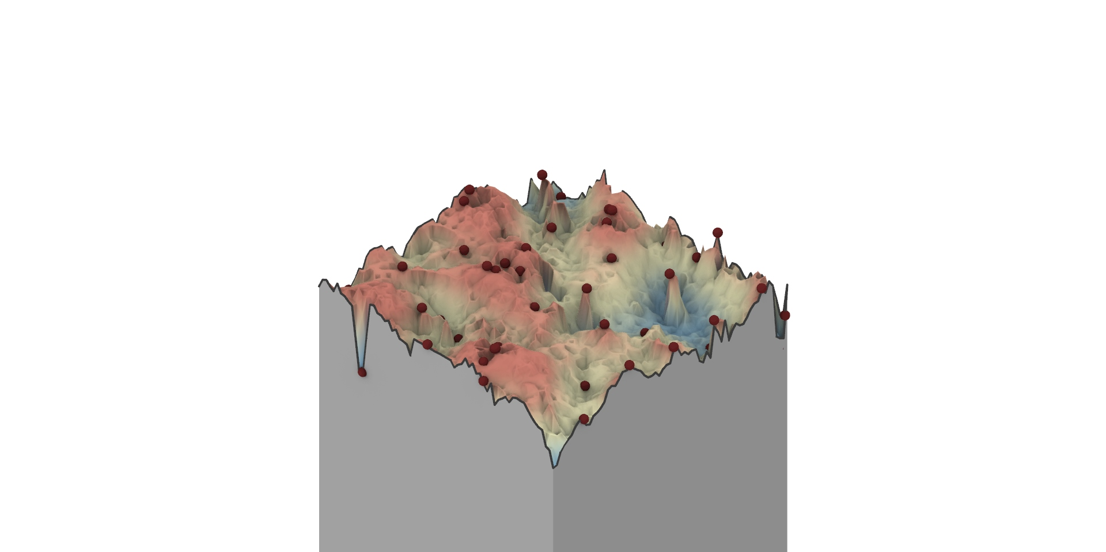
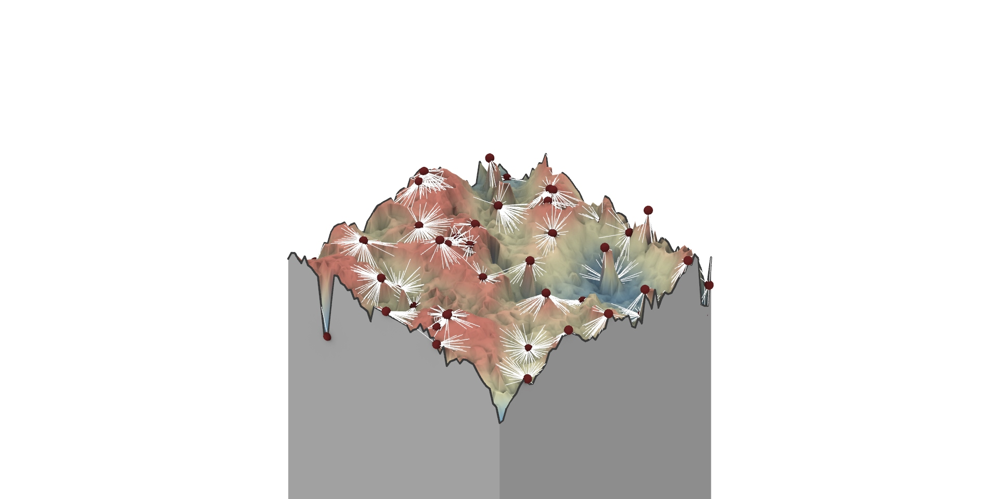
Agent Count : 60

Slide 20
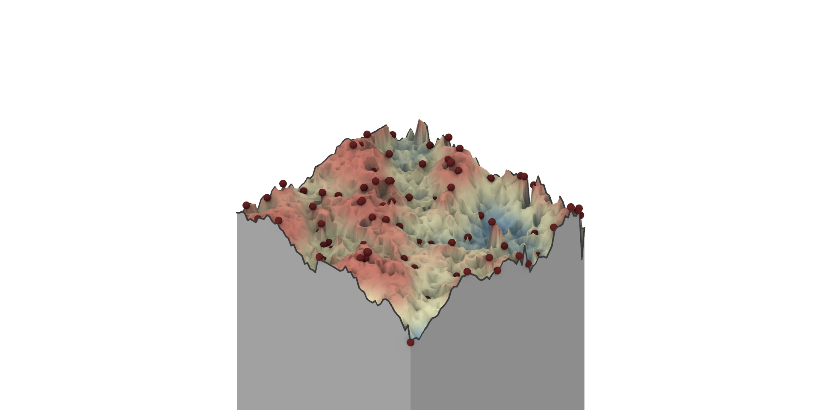
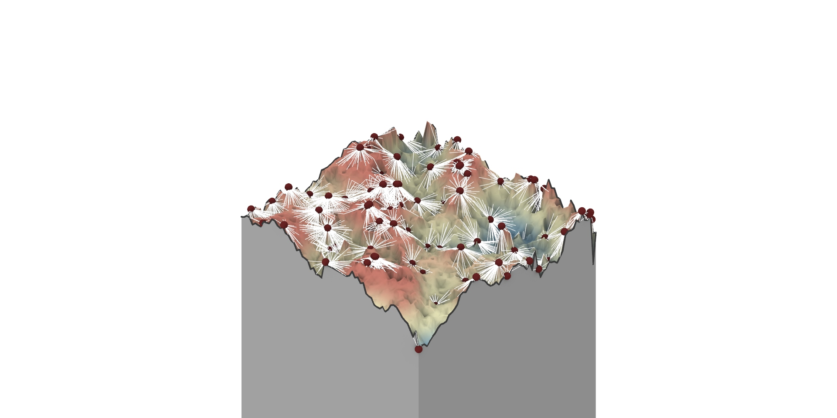
Agent Count : 100

Slide 21
Future Developments
Adding battery count
Adding a charging station agent
Mid-term point cloud memory of highest and lowest points to avoid stucking
System Evaluation
Negotiation between agents for lowest and highest points to avoid stucking
Accurate measurement of material
Various granulate behaviors on the environment (sliding, erosion)
Correlations and SOO to determine the set of agent behaviour parameters
Simulating individual capacity
What happens when each robot has its own processing unit and response speed?

